Slide 1
ConnectBud
Python
Class 6
By: Rahul Joshi

Slide 2
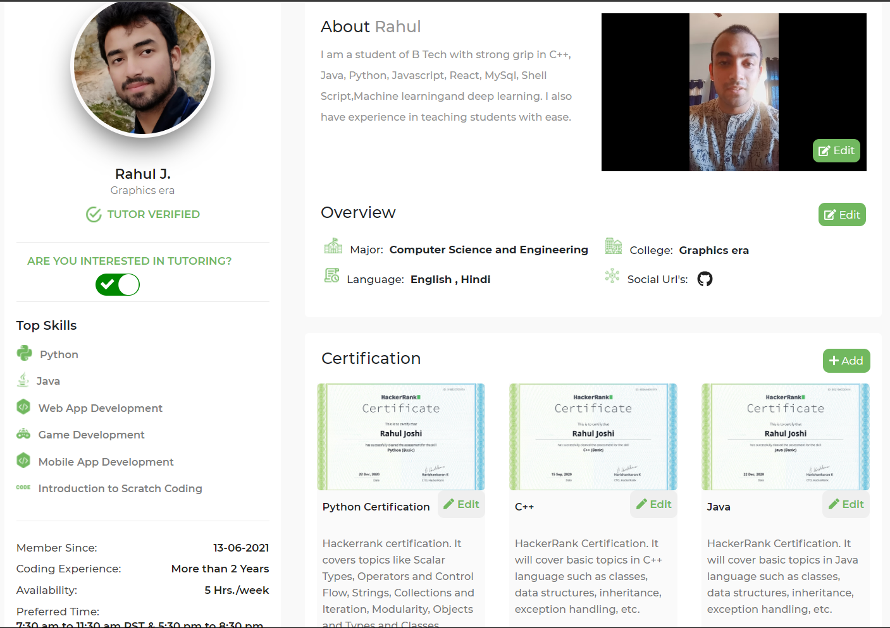

Slide 3
Class Overview
Class 6: • Operators and elif

Slide 4
Elif
age=int(float(input("insert the age")))
if age==11:
print("Hello Arav") elif age==21:
print("Hello Rahul")
elif age==30:
print("Hello 30")
elif age==40:
print("Hello 40")
else:
print("Sorry not a user")

Slide 5
Operators
Arithmetic Operator:
+,-,/,*,%(Modulus),//
Asignment Operator:
=, +=, -=, *=, /=, %=, //=.
3. Comparision Operator: (True/False)
>, <, >=, <=, ==

Slide 6
Task
Create a calculator:
Take two integer variables.
Take operator as the input(+,-,* ,/)
Perform the arithmetic operation.
Num1= 30
Num2= 40
Operation = +
Ans=70

Slide 7
End
For any queries: Contact:
Rahul Joshi rj26280218@gmail.com

